Slide 1

SalesMax.Ai
“Humanizing business, maximizing opportunities.”

Slide 2

DevilYouKnow
Mohammad Nurdin bin Norazan - Technical
Esa Ezzatinor bin Abdul Hamid - Business
Nurul Azrin binti Mohd Nasir – Quality Assurance

Slide 3
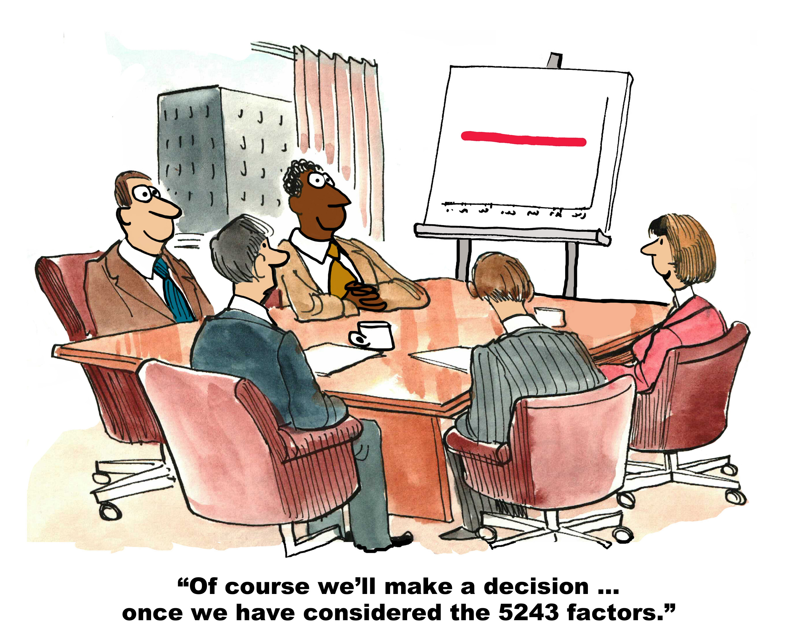

Slide 4
SalesMax.Ai
Artificial Intelligence-powered tool that allows maximization of potential sales revenue.

Slide 5
SalesMax.Ai
Identification of high potential prospects.
Cross Sell Analysis
Sentiment Analysis
Prediction of existing customers who are most likely to terminate business.

Slide 6
Tech Stack
Pandas
NumPy
Sklearn
IPython
Google Chart
Heroku
Beautiful Soup

Slide 7
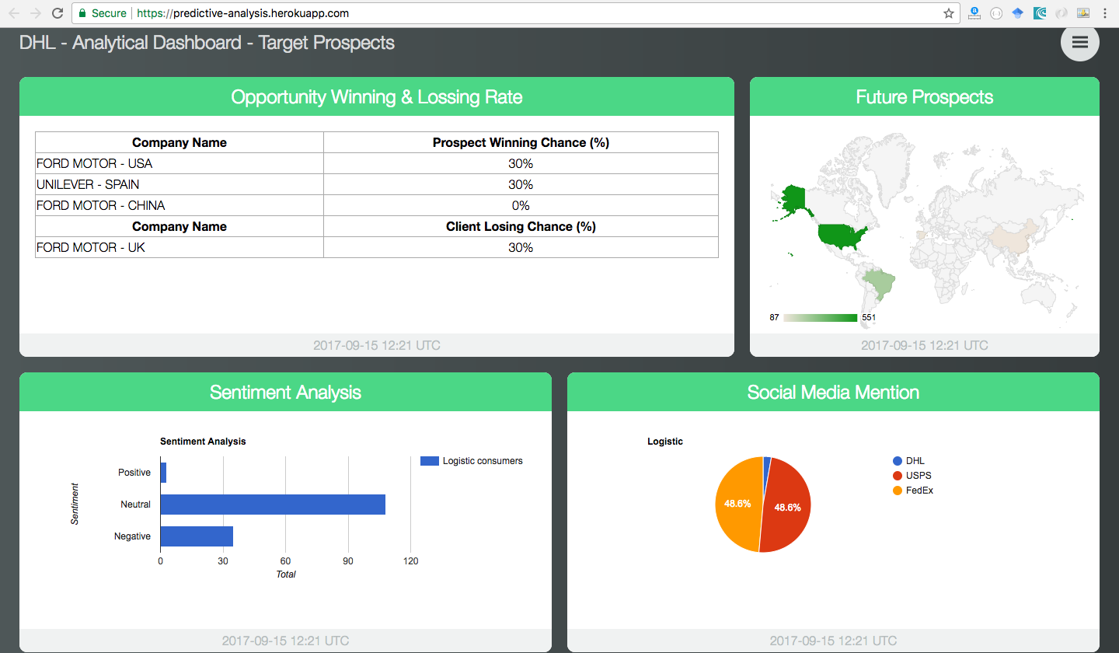
Demo - http://bit.ly/2x6eI02

Slide 8
Future Enhancement & Possible Improvement
Custom analytic dashboard (Drag & Drop)
Build & deploy dataset using CLI
Implement real time data with Big Data technology
Market movement
Deep integration with DHL CRM

Slide 9
Questions?

